Slide 1
Introduction to ASP.NET MVC
Nikolay Kostov

Slide 2
Table of Contents
A Brief History of Web Forms
ASP.NET MVC Design Goals
MVC (Model-View-Controller)
Web Forms vs. MVC
Other MVC Frameworks
Creating an ASP.NET MVC Application

Slide 3
Table of Contents (2)
Routing
Controllers
Models
Views
Testing
Action Filters

Slide 4
A Brief History of Web Forms

Slide 5
ASP.NET MVC Design Goals

Slide 6
ASP.NET MVC Design Goals
Does not replace web forms
MVC is an alternative project type
Still runs on ASP.NET
ASP.NET MVC is not build from the ground up
It still have caching, modules, master pages, data providers, handlers, session state, etc.
Embrace the web
No illusions of state, no page lifecycle
Clean URLs and clean HTML

Slide 7
ASP.NET MVC Design Goals
Extensible
Pluggable view engines
Controller factories
The new Razor view engine
Easy to learn
Easy to use
Testable
Maintains a strict separation of concerns

Slide 8
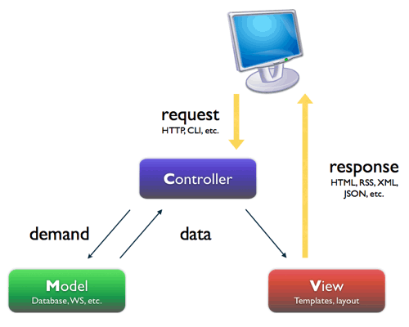
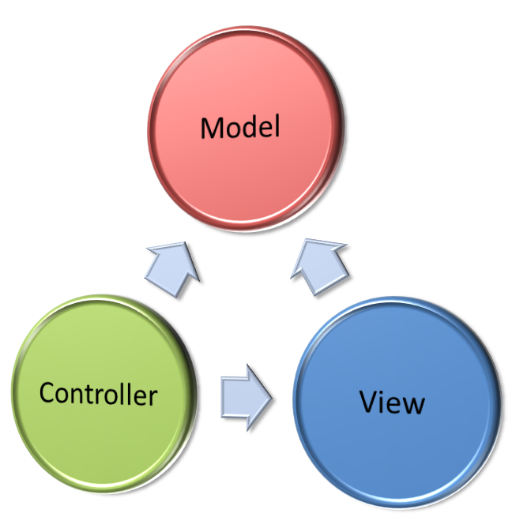
MVC (Model- View-Controller)
What is MVC and How It Works?

Slide 9
Model-View-Controller (MVC)
Model-View-Controller (MVC) architecture
Separates the business logic from application data and presentation
Model
Keeps the application state (data)
View
Displays the data to the user (shows UI)
Controller
Handles the interaction with the user

Slide 10
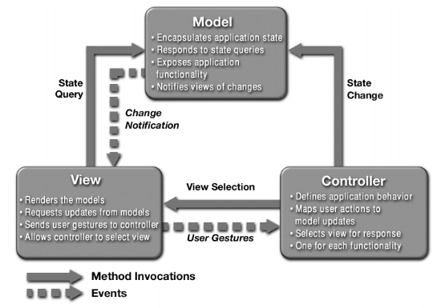
MVC Architecture Blueprint

Slide 11

MVC and Multi-Tier Architecture
MVC does not replace the multi-tier architecture
Both are usually used together
Typical multi-tier architecture can use MVC
To separate logic, data and presentation
Controllers (Business Logic)
Views (Presentation)
Model (Data)
Data Access Logic

Slide 12
Web Forms vs. MVC

Slide 13
How the Request is Handled
ASP.NET Web Forms
ASP.NET MVC
HTTP Request
HTTP Request
Route
.ASPX (Page)
Controller
View
HTTP Response
HTTP Response

Slide 14
ASP.NET Web Forms
The request is asking for specific ASPX page (specific file on the file system)
http://mysite.com/users/view.aspx?id=123
Logic and presentation are connected
The front-end (HTML) is very tightly bound to the code behind (C#, VB.NET code, etc.)
Very hard to test
You need to use browser automation tools, If you want to test your web forms application

Slide 15
What about ASP.NET MVC?
MVC routes the HTTP request to a controller
Controllers are class that you write and they are not bound to any view
The program logic (controllers) is very easy to test, because it is pure code
Controller selects the view and the data
View is something independent
Controller can decide what kind of data to return to the HTTP response
Some view (HTML), Pure text, XML, JSON, etc.

Slide 16
Other MVC Frameworks

Slide 17
Other MVC Frameworks
.NET
ASP.NET MVC, MonoRail
Java
JavaServer Faces (JSF), Struts, Spring Web MVC, Tapestry, JBoss Seam, Swing
PHP
CakePHP, Symfony, Zend, Joomla, Yii, Mojavi
Python
Django, Zope Application Server, TurboGears
Ruby on Rails

Slide 18
Creating an ASP.NET MVC Application

Slide 19
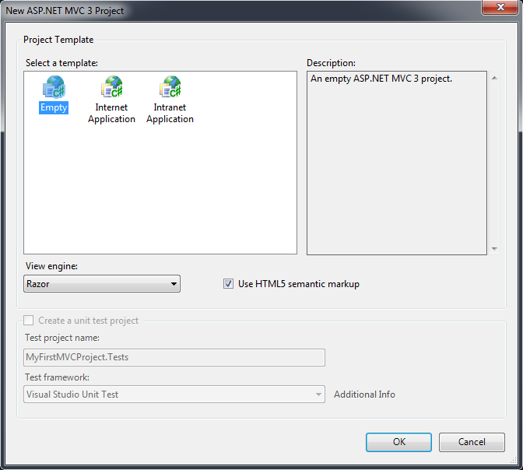
Create simple application
Open Microsoft Visual Studio 2010
File -> New -> Project… -> Visual C# -> Web
ASP.NET MVC 3 Web Application
Select a template
Empty, Internet or Intranet Application
Select a view engine
ASPX, Razor

Slide 20
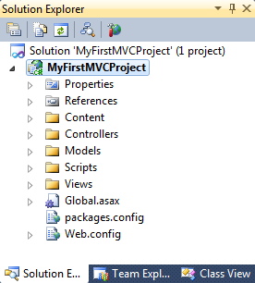
Creating an ASP.NET MVC Application Demo

Slide 21
Routing

Slide 22
MVC Routing
Define routes during application startup
Map URLs to controller action with parameters
Defines patters for URL matching
System.Web.Routing namespace
Similar functionality as ModRewrite in Apache
Routes are defined in RegisterRoutes() in Global.asax file:
First rule matching will process the request
public static void RegisterRoutes(RouteCollection routes)

Slide 23
Route Example
routes.MapRoute(
"Default", // Route name
"{controller}/{action}/{id}", // URL with parameters
new {
controller = "Home",
action = "Index",
id = UrlParameter.Optional } // Parameter defaults
);
If the URL ends with …/…/… the route uses first part as controller name, second as action name and third as parameter named "id"
For each missing part, the route selects default value (Home for controller, Index for action and sets "id" as an optional parameter

Slide 24
Routing demo

Slide 25
Controllers

Slide 26
Controllers
When the ASP.NET determines the proper route, it invokes selected method (called action) from your controllers
Controller represents the business logic of the application
Tells the framework where to go next
Return value of ActionResult
Select the output (View, JSON serialized data, pure text, XML serialized data, etc.)
Can build the data and pass it to the view

Slide 27
Controller Example
public class HomeController : Controller
{
//
// GET: /Home/
public ActionResult Index()
{
return View();
}
}

Slide 28
Controllers Demo

Slide 29
Views

Slide 31
Views demo

